Slide 1
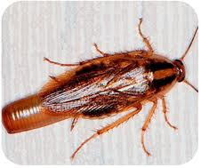
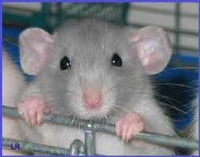
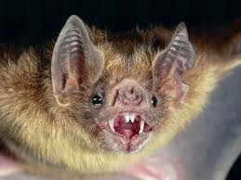
Roaches, Rats 'n' Bats.
About Cockroaches, Rats, and Bats.

Slide 2
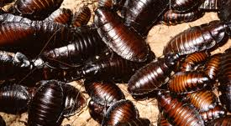
Cockroaches:

Slide 3
Facts
A cockroach has white blood.
They can live a month without food.
They can survive a nuclear blast.
Cockroaches can also survive having their head cut off.
They are mostly considered pests, but some keep them as pets.

Slide 4
Habitat.
They live in hot, humid areas.
There are American cockroaches, Asian cockroaches, and Madagascar hissing cockroaches.
If someone tells you there are German cockroaches, its not true. There is no such thing.

Slide 5
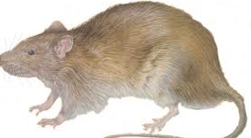
Rats

Slide 6
Facts:
A group of rats is called a mischief.
They have poor eyesight, and are color blind.
Rats can’t throw up.
The Black Plague was not caused by rats, it was caused by the fleas on the rats.

Slide 7
Habitat:
They like to live in dark damp places.
They live in all continents, except for Antarctica.

Slide 8

Bats

Slide 9
Facts:
Bats are not blind.
Bats are the only mammals that can fly.
The smallest bat in the world is the Bumblebee Bat.
Vampire bats only drink blood from animals.

Slide 10
Habitat
Most bats live about everywhere, except where it is too hot, or too cold.
Some bats, like the vampire bat, live in the Amazon.

Slide 11
The End
Roaches, Bats, and Rats are usually considered pests and vermin, but sometimes they are kept as pets, and some people eat cockroaches.

Slide 12
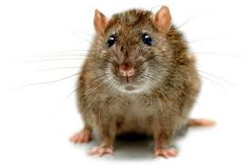
Images:

Slide 13
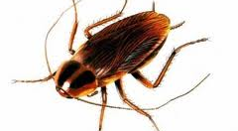
Images:

Slide 14
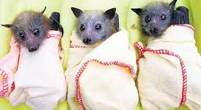
Images:

